Slide 1



ENRON Scandal & Its Implications in BE & CG
Prabesh Adhikari
Shishir Acharya
Subhechhya Tuladhar

Slide 2
Table of Contents
Introduction to Company
Hiring
Accounting System
Revenue and Profit
Special Purpose Entity/Vehicle

Slide 3
1. Introduction
Founded in 1985 by Kenneth Lay
Headquartered in Houston, Texas, USA
With the merger of Houston Natural Gas and InterNorth
Originally Focused in Natural Gas and Energy Trading
Major Player in electricity, natural gas, communications and pulp & Paper Industry

Slide 4
1.1 Business Model
Transition from energy company to financial trading powerhouse
Use of complex financial instruments
Aggressive growth and expansion strategy

Slide 5
1.2 Key Persons
Kenneth Lay (Chairman & CEO)
Jeffrey Skilling (COO)
Andrew Fastow (CFO)

Slide 6
2. Hiring
Mr. Lay hired Consulting firm “McKinsey and Company”
Jeffery Skilling got appointed as consultant
Mr. Skilling started to work as consulted on business strategy
Enron started to invest in risky businesses

Slide 7
Skilling joined Enron | 1990 as COO
Hired Andrew Fastow as CFO
Mr. Fastow is known do complex billings and keep accounting complex
Very clear on how they will prepare financial statements and keeping the as complex as they could

Slide 8
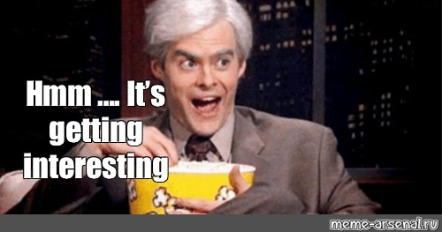

Slide 9

Performance Review System
Respect
Integrity
Communication
Excellence

Slide 10
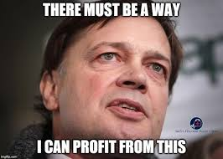

Yes! How much profit you can bring?

Slide 11
Diverging Investments
Internet Broadband
Power Plants
Commodity Trading

Slide 12
Further
Failed in many sectors
Faced Loss
Started to show fake revenues
Required Capital
Debt Plan

Slide 13
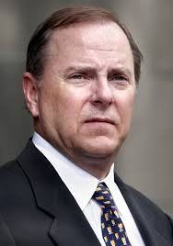
Hey Andrew, What should we do?
Hmm!! Let’s Brain Storm
New Accounting System!!
From 1992

Slide 14
Accounting System
Historical Cost Accounting System
Mark to Market Accounting

Slide 15
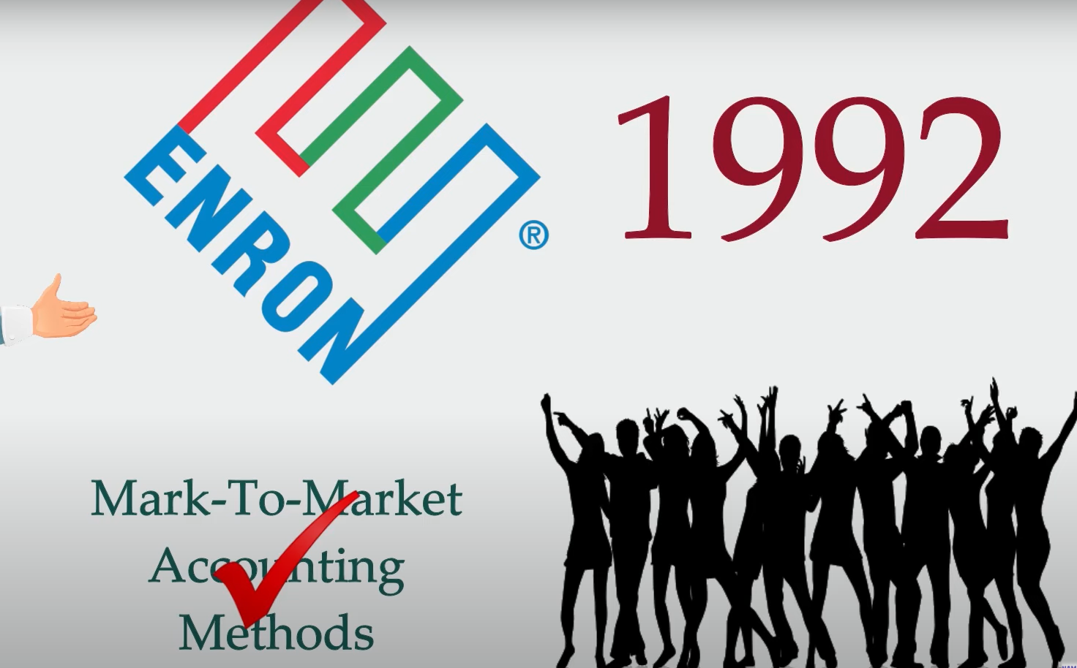
Let’s Party!!

Slide 16
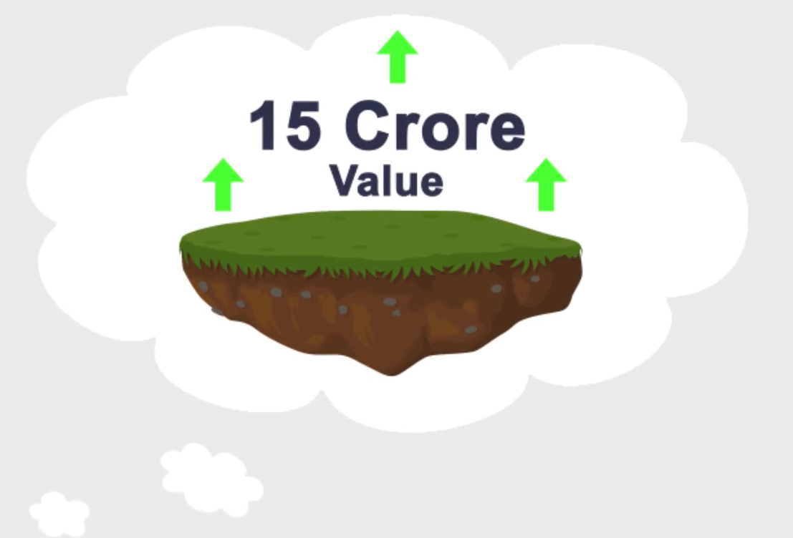
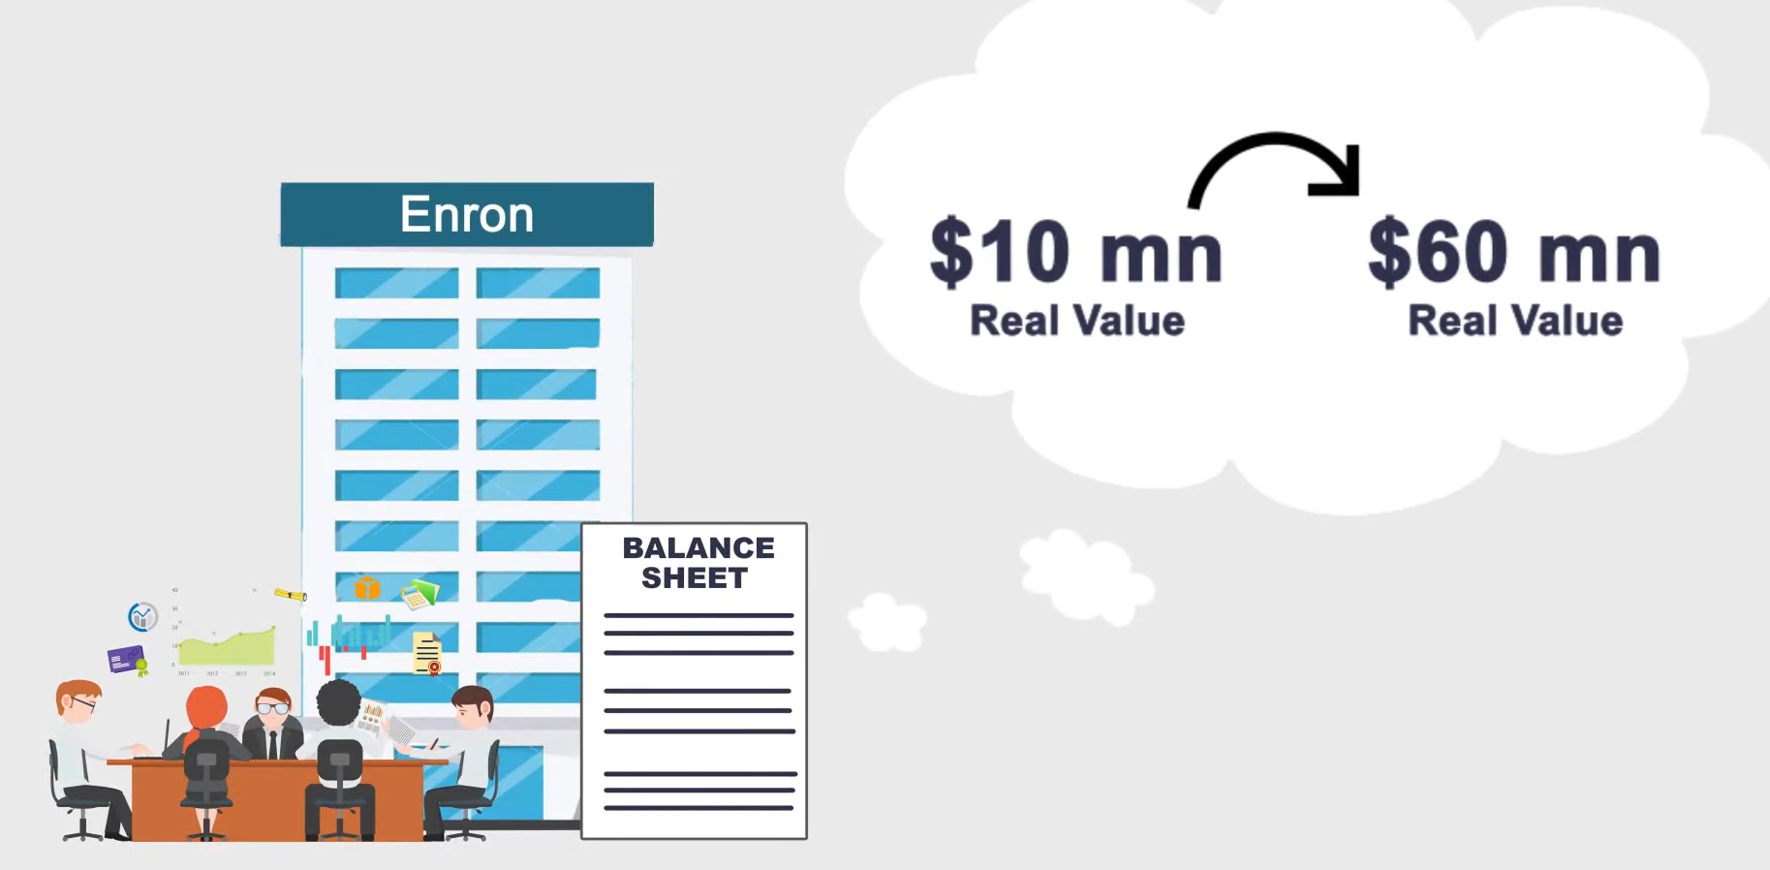
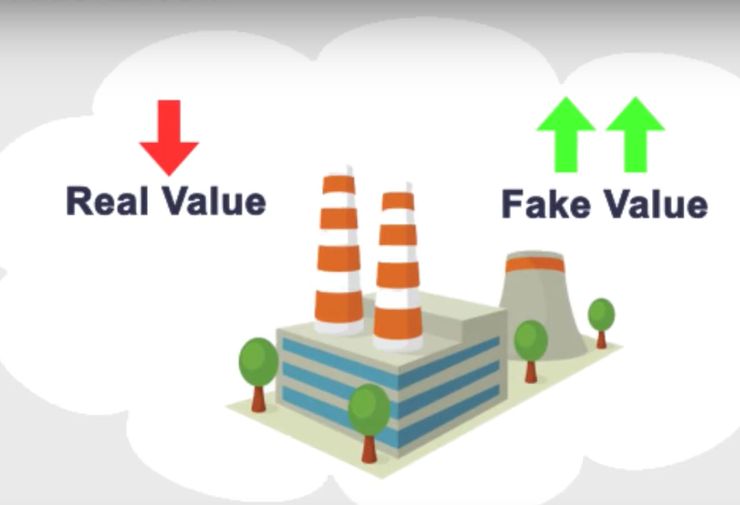
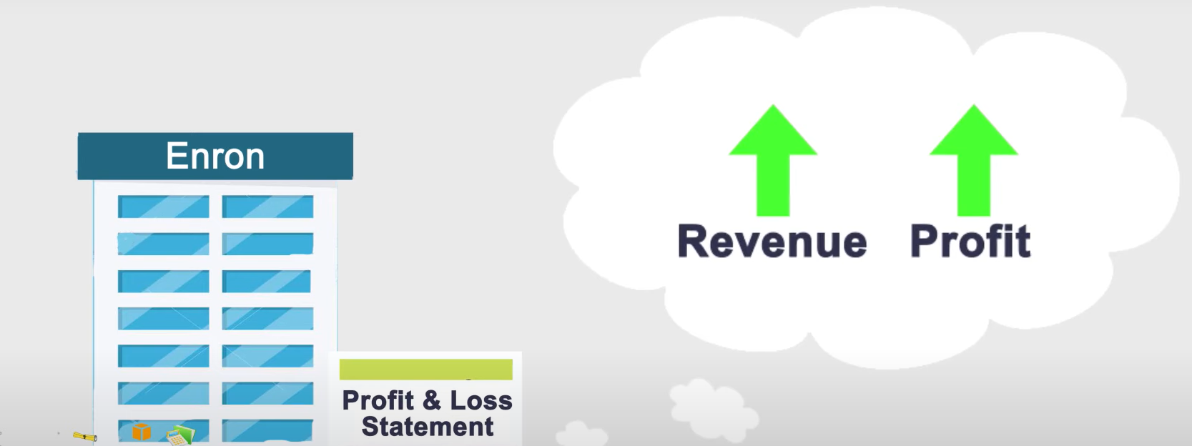
Fake Values

Slide 17
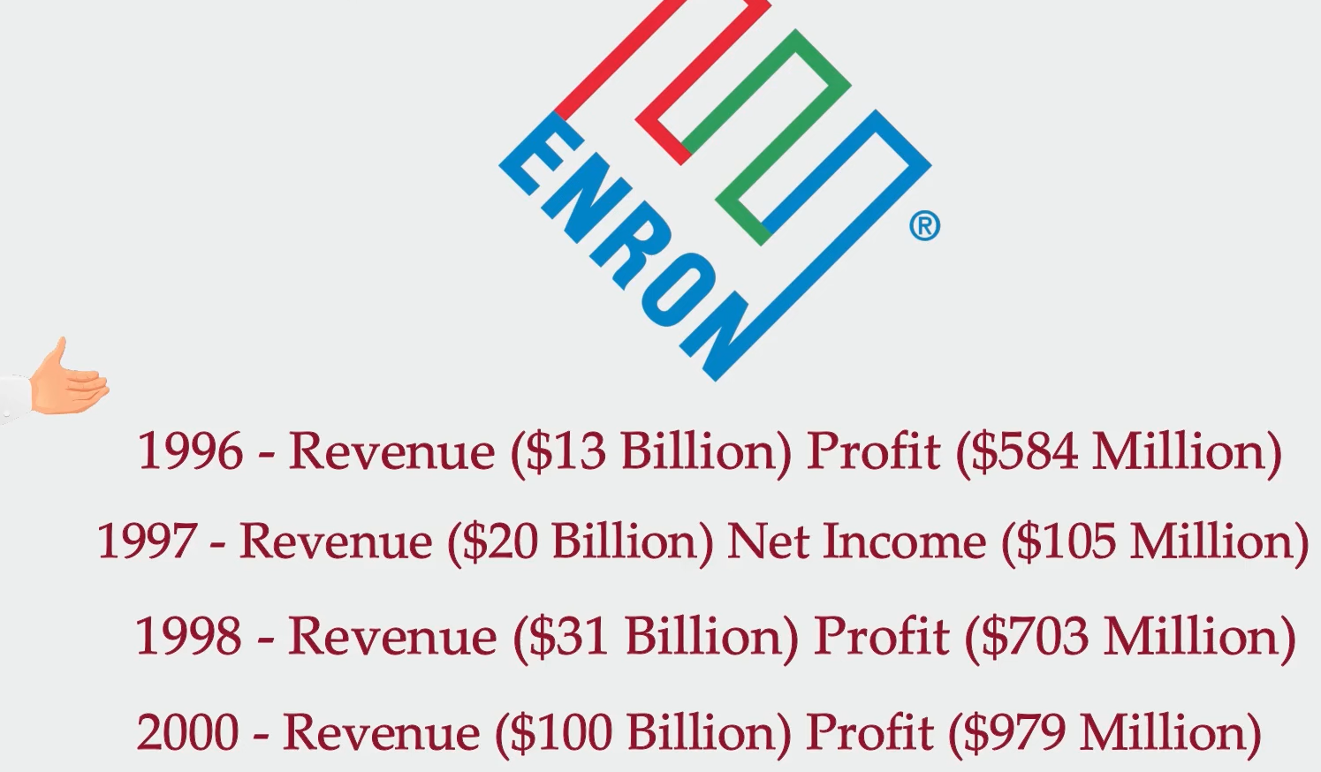

Slide 18
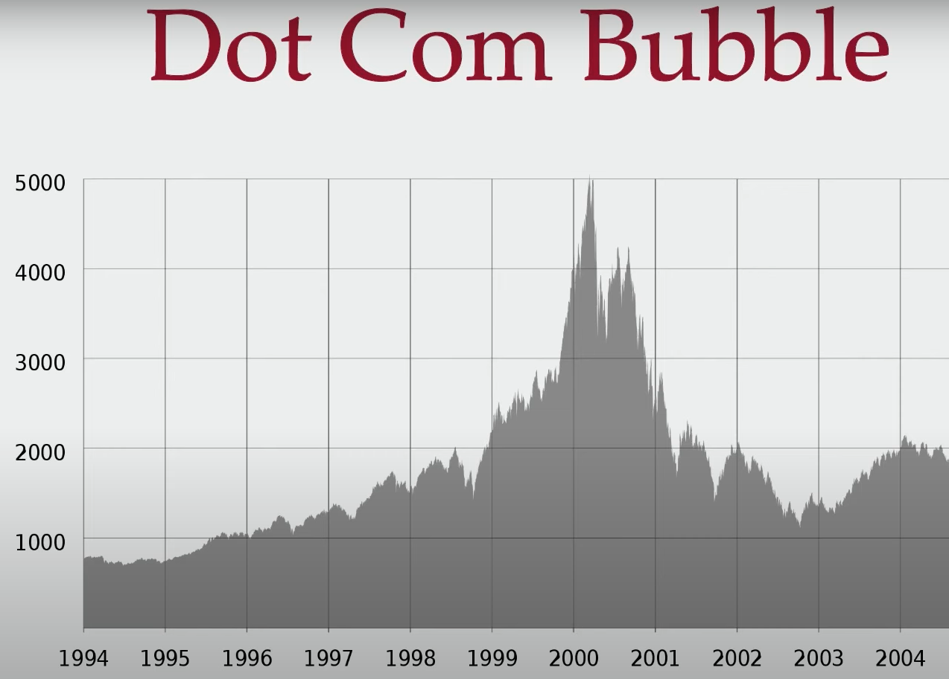

Slide 19
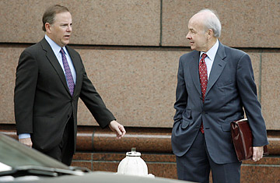
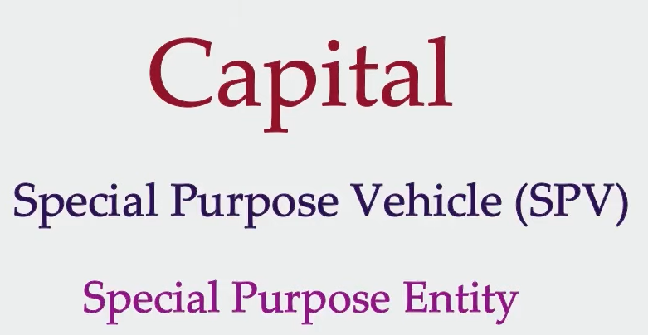

Slide 20
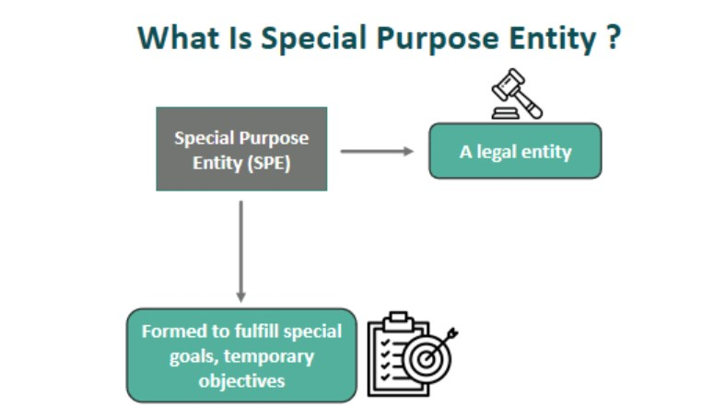
SPV/SPE

Slide 21
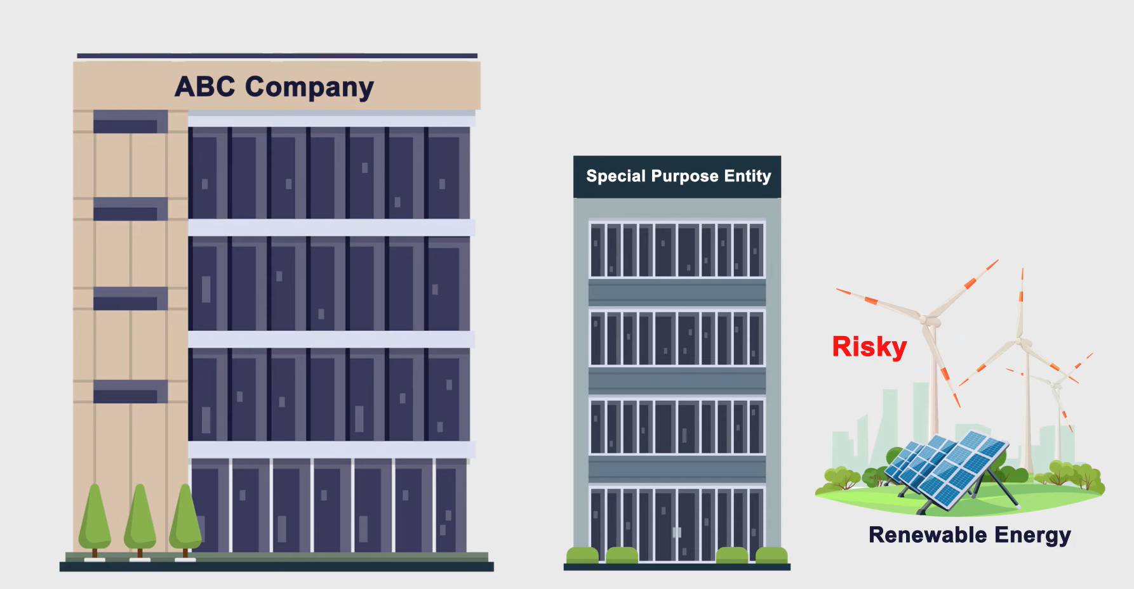

Slide 22
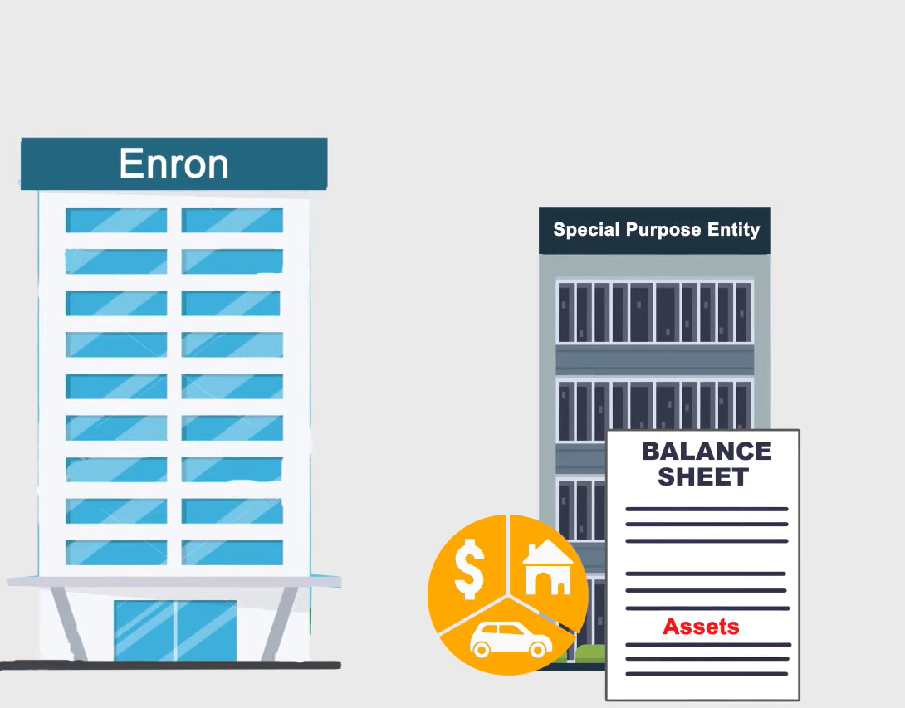
Transfer Assets

Slide 23
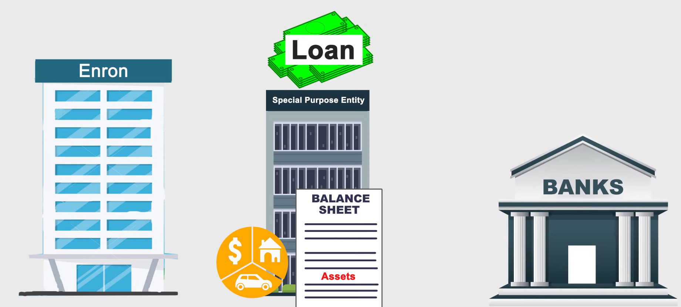

Slide 24
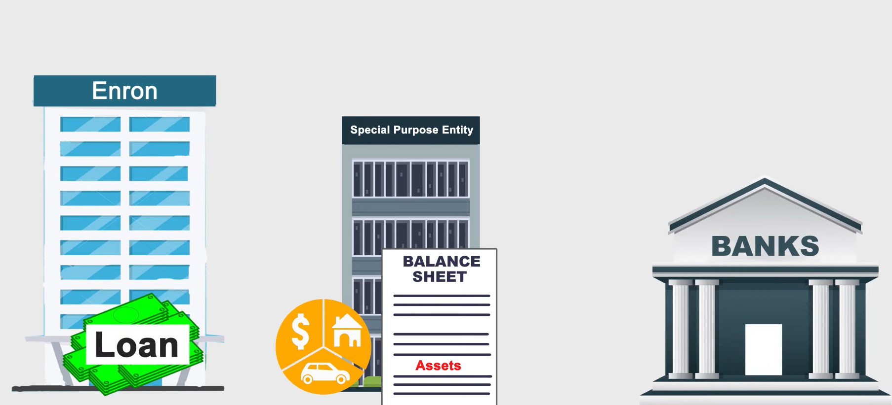
Raised Capital

Slide 25
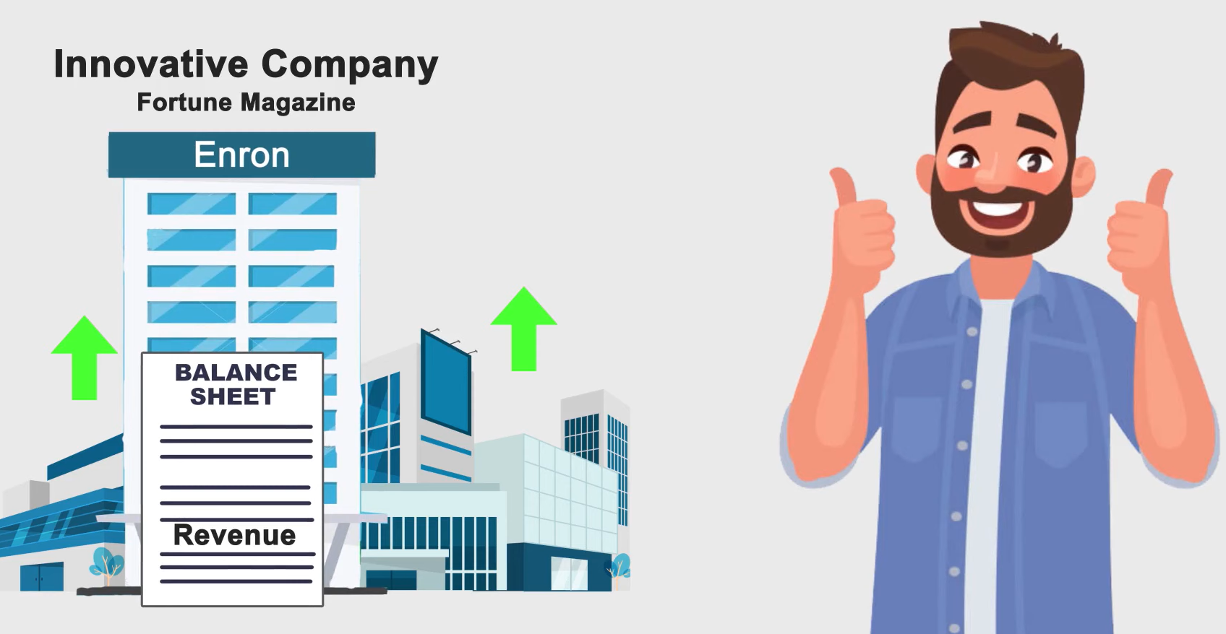
Again
Transferred Assets were billed as sales

Slide 26
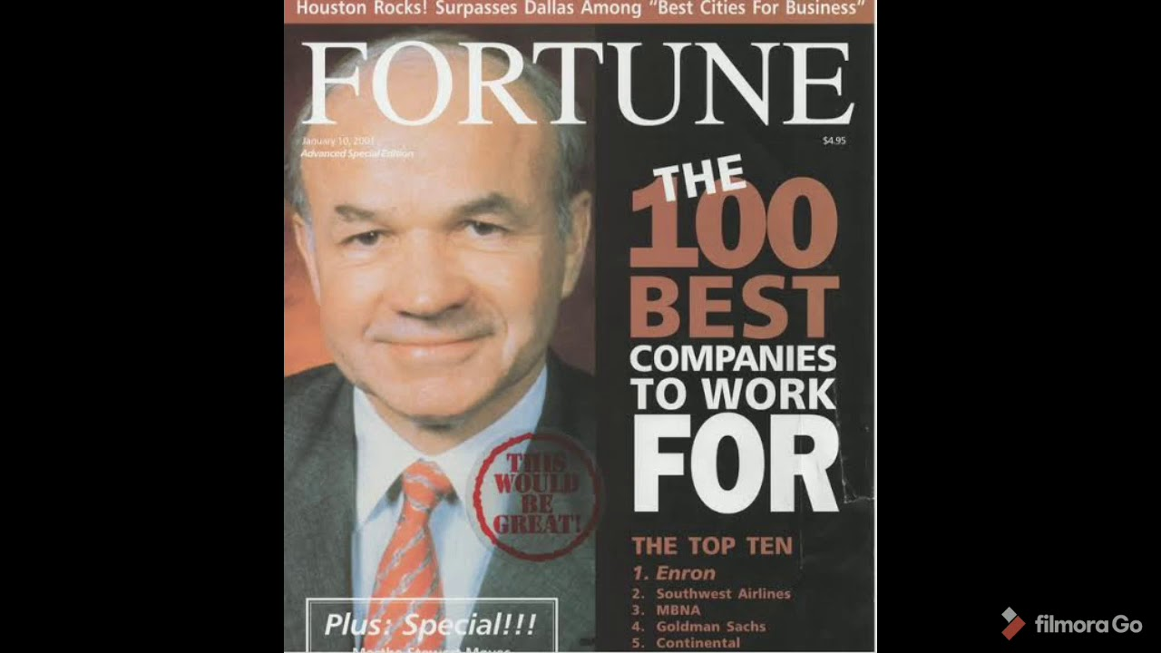
6 Years on Fortune Magazine

Slide 27
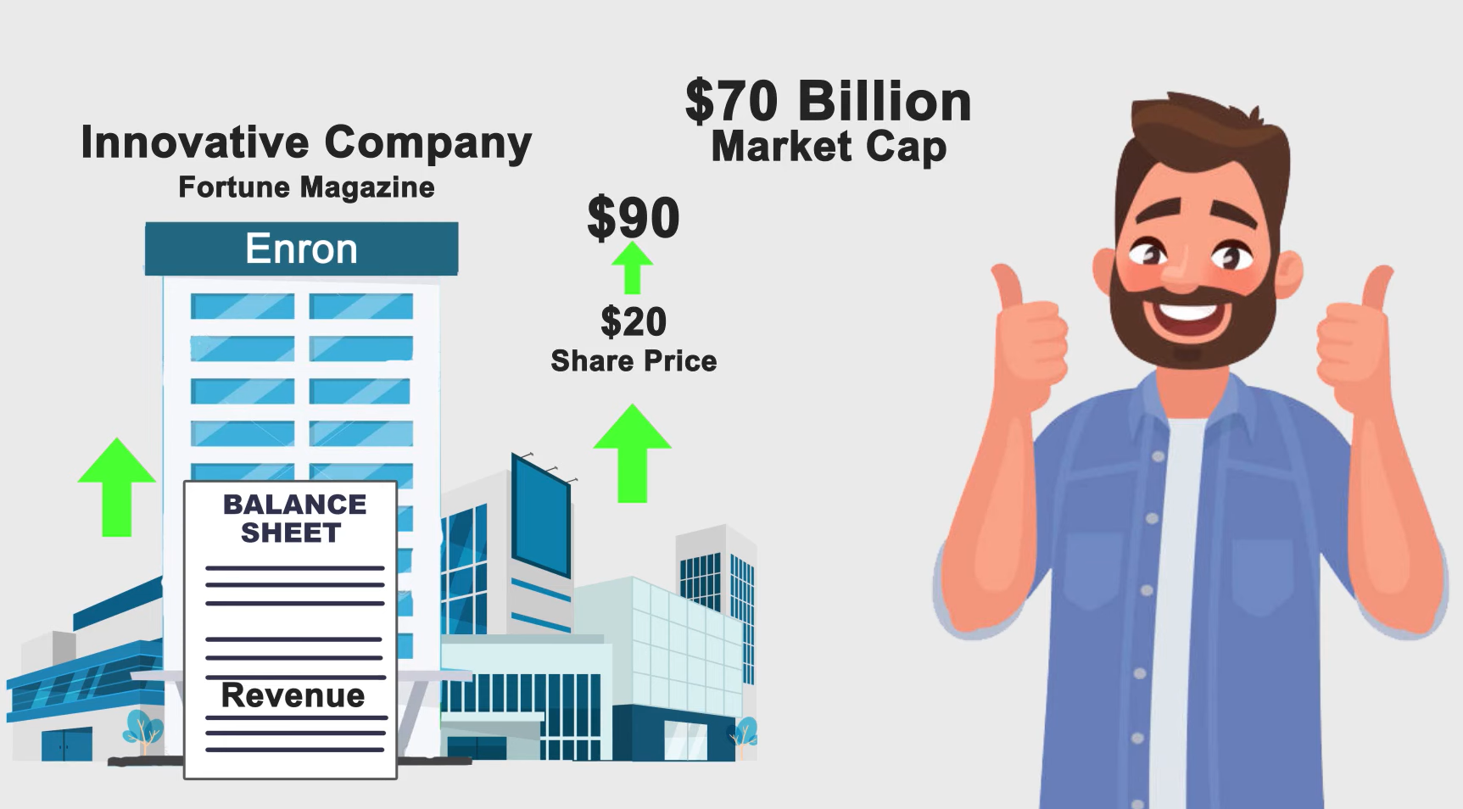

Slide 28
Role of Arthur Anderson
Enron's external auditor
Destruction of critical documents
Failure to highlight financial irregularities

Slide 29
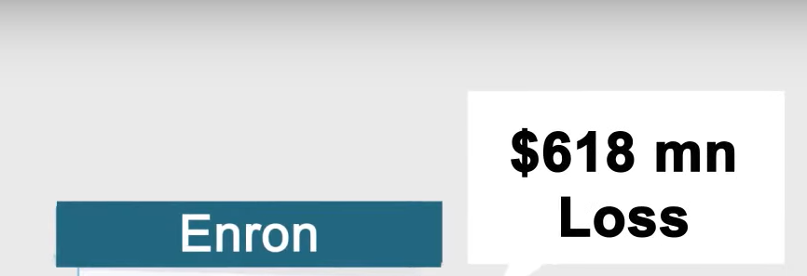

Oct 2001

Slide 30
Signs of Trouble
Stock price fluctuations
Employee whistleblowers
Analyst concerns about lack of transparency

Slide 31
Unravelling of Enron
Market reaction and loss of investor confidence
Jeffrey Skilling resigns in 2001
SEC investigation begins

Slide 32
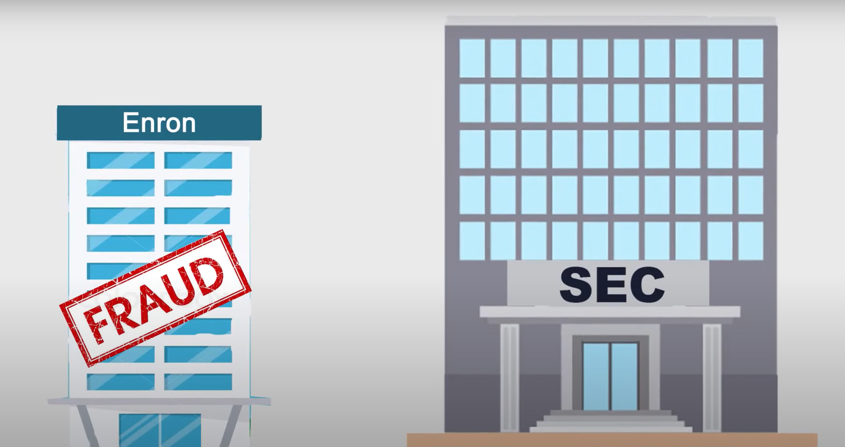

Slide 33
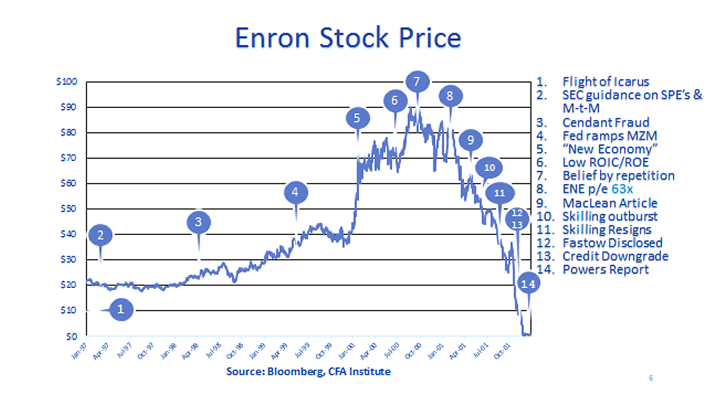

Slide 34
Backlogs
Investors Lost Billions
CEO and COO charged for Fraud
Thousand Lost Jobs
Emotional and Financial Damage
Damage to public trust on public companies

Slide 35
Takeaway
Importance of transparency in financial reporting
Need for ethical corporate governance
Role of auditors in preventing fraud

Slide 36
Short Summary
1992
Accounting Methods Change
2000
High Valued Company
2000
Filed For Bankruptcy

Slide 37
Still a Legacy
Case study in business schools
Ongoing discussions on corporate ethics
Influence on financial regulations
Documentaries and books on Enron
Cultural impact and portrayal in media
Continued discussions on corporate fraud

Slide 38
Current Corporate Governance Trends
Increased regulatory scrutiny
Ethical investment strategies
Greater emphasis on corporate social responsibility (CSR)

Slide 39
Sources
https://www.britannica.com/event/Enron-scandal/Downfall-and-bankruptcy
https://www.fbi.gov/history/famous-cases/enron
https://www.investopedia.com/updates/enron-scandal-summary/
https://www.learnsignal.com/blog/the-enron-scandal-overview/
https://internationalbanker.com/history-of-financial-crises/the-enron-scandal-2001/
Aduda, Chogii & Magutu (2013). An empirical test of competiting corporate governance theories
Babic, Jelena & Jelena (2010). Rethinking Board Role Performance: Toward An Integral Model (1-23).

Slide 40


Slide 41


